Slide 1
CAACC : Hnefetafl
P4 : Design and Implementation (ii)

Slide 2
Changes to Previous Documents

Slide 3
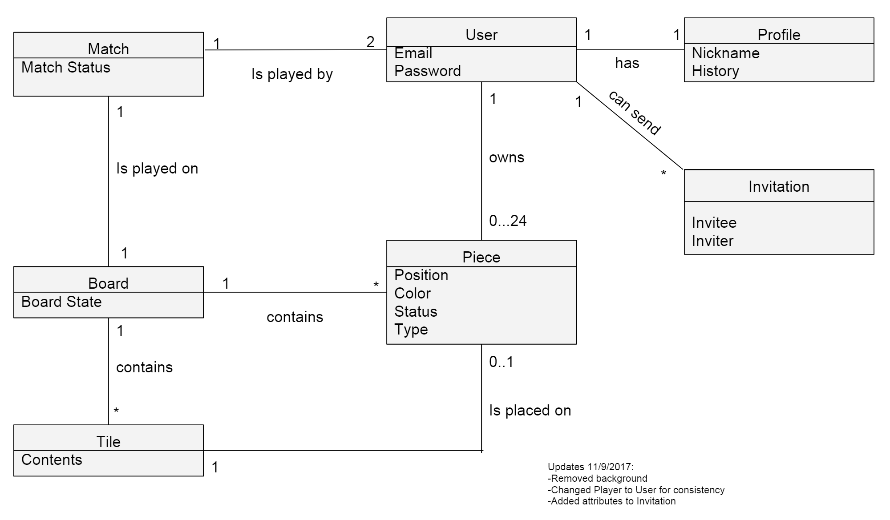
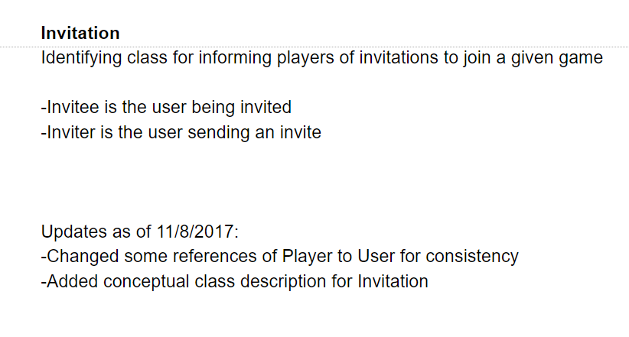
Domain Model and Glossary
Added attributes to Invitation, described in glossary
Changed Player to User for consistency throughout
Removed background on Domain Model

Slide 4
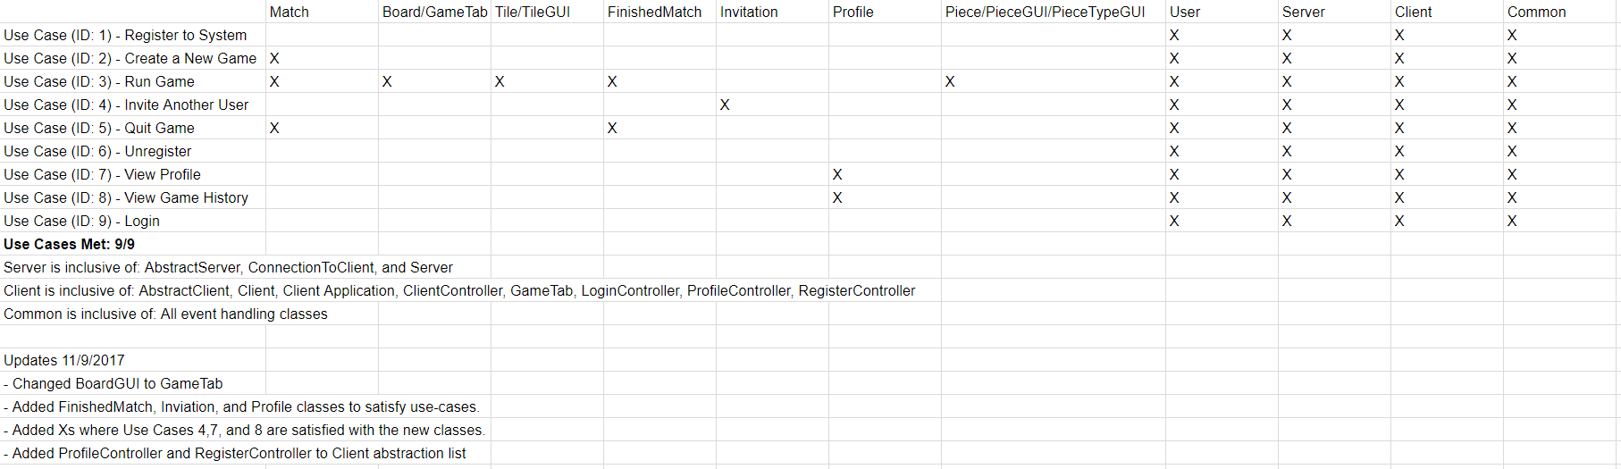
Traceability Link Matrix
Changed class names for consistency
Added values where new Use Cases were satisfied.
ie. Invite, Quit Game, View Profile, View History, Unregister

Slide 5
New Documents for this Deliverable

Slide 6
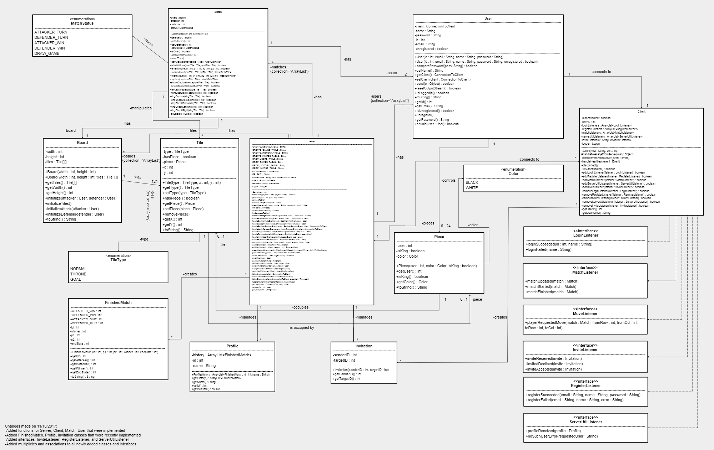
Design Class Diagram
Added new classes to satisfy all use-cases.
Profile (includes History)
Invitation
FinishedMatch
Added to existing classes when changes were made.
Server
Client
Match
User

Slide 7
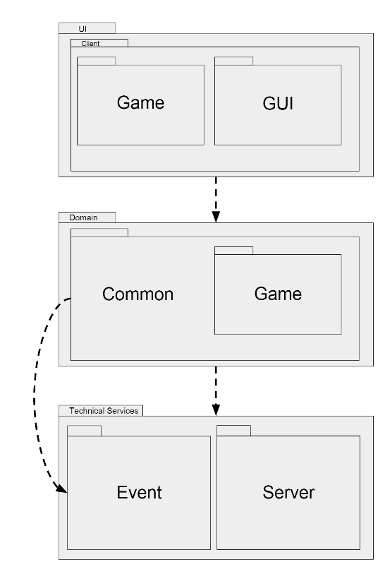
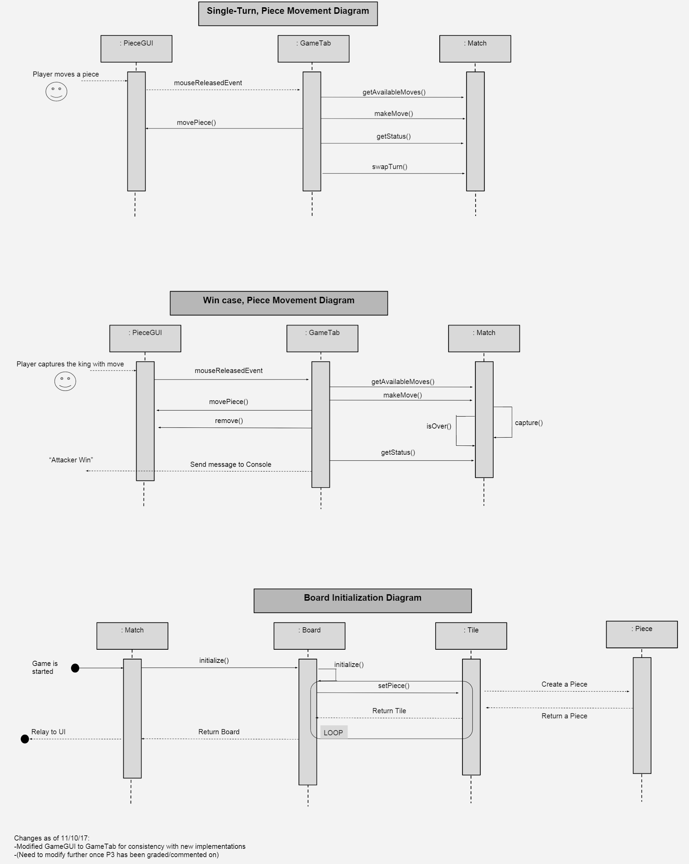
Package and Sequence Diagrams, along with System Test Document
Sequence Diagrams
Class names were changed to keep consistency.
Further adjustments will be made following P3 feedback.
System Test Document
Added test cases for new functionalities
Invite
Unregister
Register
Quit

Slide 8
Refactoring

Slide 9
Refactoring
Extract Method
Exceptionally large methods in Match broken into new, more cohesive methods.
KingCapture
Capturable
Extracted login and password logic from vague, dense EventHandler method to a specialized EventHandler method.
Consolidate Conditionals
Consolidated many if-else’s to one method call in both:
Capturable method
KingCapture method

Slide 10
Refactoring (cont.)
Extract Interface
Created interfaces for Login, Register, and Invite in Server, from what used to be large methods.
Encapsulate Fields
Some variables in Client and Server were given setters/getters and made private. No need to be public here.

Slide 11
Design Patterns
Controller:
Client inputs are directed to the ClientController class, which interacts with the Match
Model-View-Controller (MVC) pattern
Polymorphism: Regarding the base class “event”
Assures that all events implement serializable
Pass around abstract references as parameters and return types; greatly increases flexibility
Information Expert: Clearly seen in the game hierarchy
A Match has the information needed to create a Board
A Board has the information needed to handle the Tiles

Slide 12
Now for a demo...

